Slide 1
Web-based tools for analyzing satellite Earth observations and ground data
SCGIS 2019 Technical Workshop
Tuesday, July 16, 2019
Please create a NASA Earthdata Login at: https://urs.earthdata.nasa.gov/
Cole Krehbiel¹
¹LP DAAC Remote Sensing Scientist
Innovate!, Inc., contractor to USGS EROS
Sioux Falls, South Dakota
*Work performed under USGS contract G15PD00766
Cindy Schmidt²
² Associate Program Manager, Applied Sciences Ecoforecasting Program, ARSET Land Management team lead
Bay Area Environmental Research Institute
Moffett Field, CA
U.S. Department of the Interior
U.S. Geological Survey

Slide 2
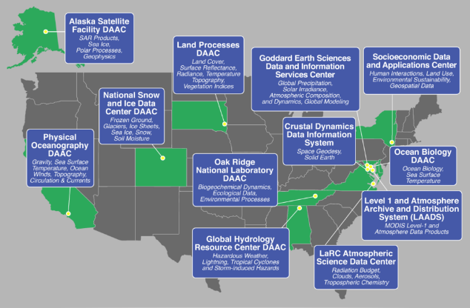
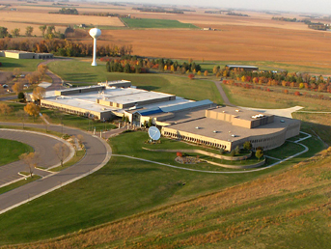
NASA’s Land Processes Distributed Active Archive Center (LP DAAC)
Located in Sioux Falls, SD at the U.S. Geological Survey (USGS) Earth Resources Observation and Science (EROS) Center
One of twelve NASA Earth Observing System Data & Information System (EOSDIS) DAACs
https://lpdaac.usgs.gov

Slide 3
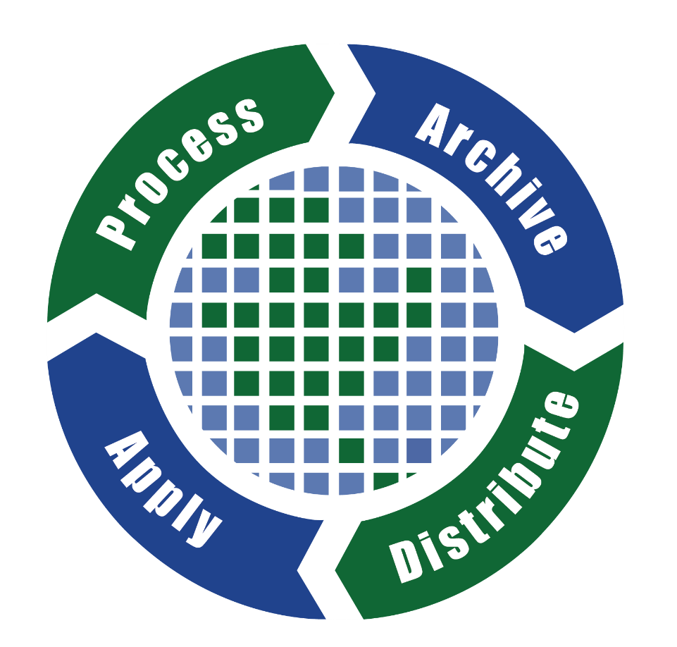
What does the LP DAAC do?
“Process, archive, and distribute publicly-available land data products to advance the access, understanding, and use of data for large and diverse user communities”

Slide 4
Introduction to LP DAAC Data Products
MEaSUREs
Community
Terra & Aqua MODIS
Terra
ASTER
S-NPP
VIIRS
New ISS Missions:
Ecosystem Spaceborne Thermal Radiometer on Space Station (ECOSTRESS)
Global Ecosystem Dynamics Investigation (GEDI)

Slide 5
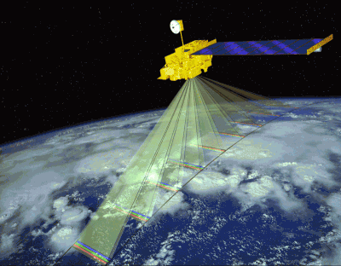
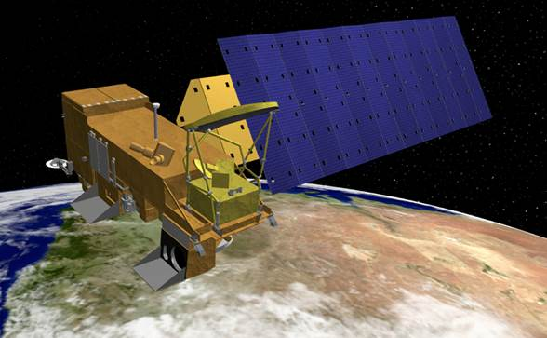
Terra and Aqua MODIS
Moderate Resolution Imaging Spectroradiometer
MODIS sensors aboard Terra (1999) & Aqua (2002)
Measure large-scale global dynamics across land, oceans, and atmosphere
Daily, continuous, global, multispectral, multi-temporal data
Holistic record of Earth’s parameters
Terra
Aqua

Slide 6
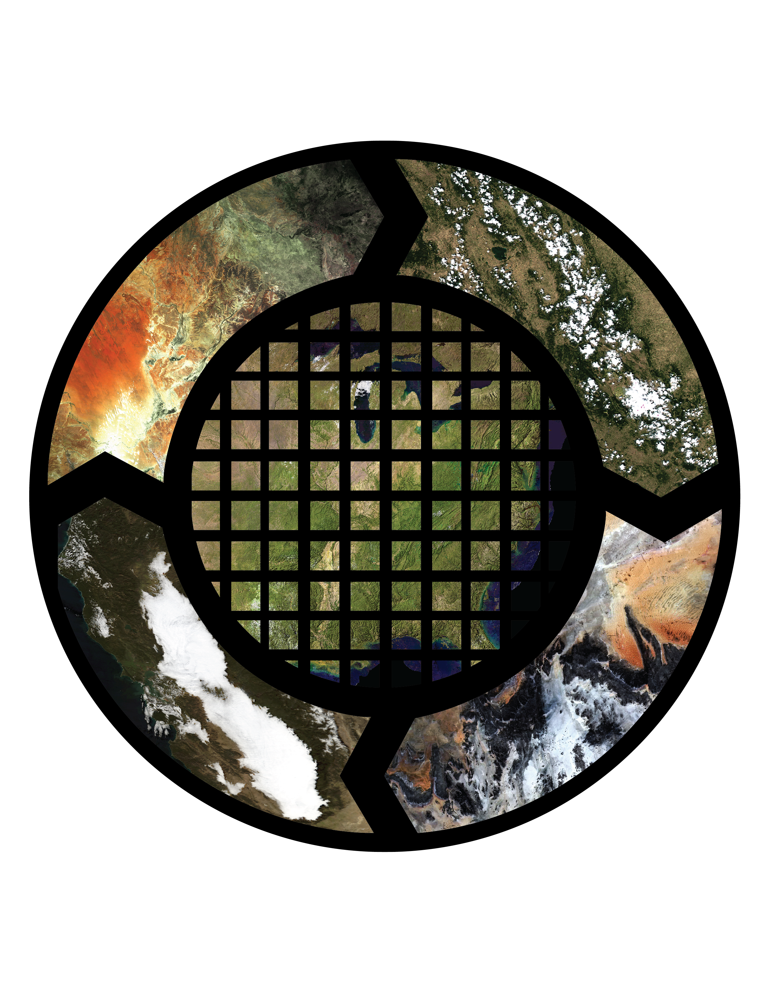

MODIS Land Data Products
Terra, Aqua, and Combined Products
Level 2 & 3 land products
Version 6
Temporal Coverage | 2000 (Terra), 2002 (Aqua) - Present
Spatial Coverage | Global
Spatial Resolution | 250 m, 500 m, 1,000 m, 5,600 m
Temporal Resolution | Daily, 4-day, 8-day, 16-day, Monthly, Annual
Spectral Resolution | 36 bands ranging from 0.4-14.4 microns
Data Types | Swath, Tile, Climate Modeling Grid
Unique Products | ~160

Slide 7
MODIS: Moderate Resolution Imaging Spectroradiometer
Land Cover and
Vegetation Cont. Fields
Land Surface Temperature
and Emissivity
BRDF
And
Albedo
Vegetation
Indices
Thermal Anomalies, Fire, and Burned Area
Leaf Area
Index and
FPAR
Gross & Net Primary
Productivity
Surface Reflectance

Slide 8
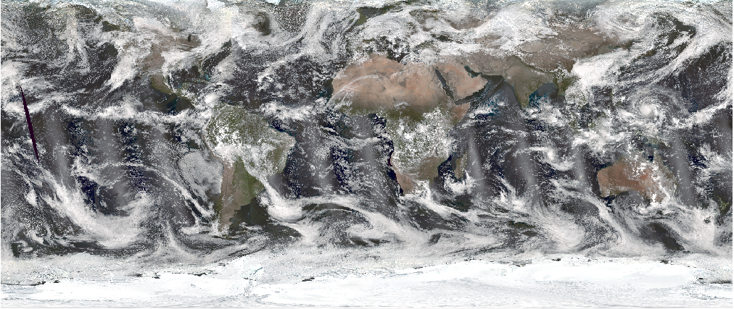
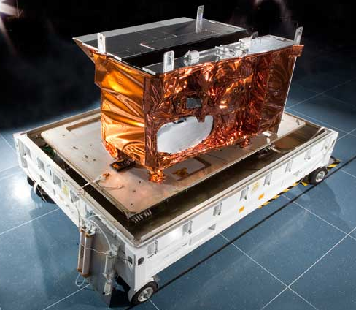
VIIRS: Visible Infrared Imaging Radiometer Suite
Onboard the Suomi National Polar-orbiting Partnership (S-NPP) Satellite
NOAA/NASA Partnership
NASA VIIRS data products extend legacy of Terra/Aqua MODIS (2012-Present)
NASA VIIRS global change observation products are generated in MODIS-like format using modified MODIS algorithms.
Daily, continuous, global, multispectral, multi-temporal data
No gaps in daily coverage due to wider swath width

Slide 9
VIIRS Land Data Products
Level 2-4 Products
Version 1
Distributed as HDF-EOS5 files
Temporal Coverage | January 19, 2012 - Present
Spatial Coverage | Global
Spatial Resolution | Resampled to: 500 m, 1,000 m, 5,600 m
Temporal Resolution | Daily, 8-day, 16-day, Monthly, Annual
Spectral Resolution | 22 bands ranging from 0.4-14.4 microns
Data Types | Swath, Tile, Climate Modeling Grid
Unique Products | 25 and growing!

Slide 10
Currently Available VIIRS Products
Leaf Area Index and FPAR
Vegetation Indices
Thermal Anomalies and Fire
Surface Reflectance

Slide 11
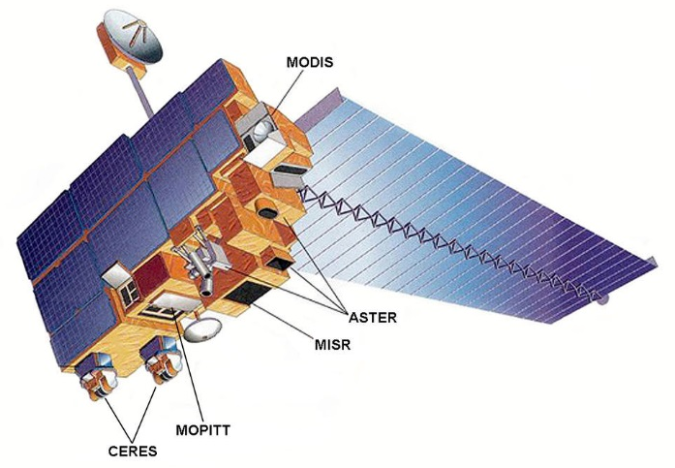
ASTER: Advanced Spaceborne Thermal Emission & Reflection Radiometer
Multi-resolution instrument onboard Terra (1999)
Japan (METI, AIST, J-spacesystems) & NASA Partnership
Tasked Sensor: Pointable and able to collect data at night
Applications include:
Geology and soils
Urban studies
Vegetation/ecosystem dynamics
Volcanos
Hazards monitoring
Hydrology
Land change
Glacier Monitoring
Shortwave Infrared (SWIR)
30 m resolution
Thermal Infrared (TIR)
90 m resolution
Visible and Near Infrared (VNIR) 15 m resolution
For more information on ASTER: https://lpdaac.usgs.gov/dataset_discovery/aster/

Slide 12
NASA MEaSUREs: Making Earth Science Data Records for Use in Research Environments
Vegetation Continuous Fields (VCF)
Land Surface Temperature & Emissivity (LSTE)
Vegetation Index and Phenology (VIP)
Global Food Security Support Analysis Data (GFSAD)
Global Forest Cover Change
NASA Shuttle Radar Topography Mission (SRTM) v3
Web-Enabled Landsat Data (WELD)
Community Products
ASTER Global Emissivity Database (GED)

Slide 13
New and Incoming Products
ECOSTRESS: Ecosystem Spaceborne Thermal Radiometer Experiment on the Space Station
GEDI: Global Ecosystem Dynamics Investigation full waveform LIDAR
ASTER GDEM V3
GWELD: Global WELD
MODIS Version 6.1
Additional VIIRS Products:
Land Surface Temperature
BRDF/Albedo
Burned Area
Land Cover Type
NASADEM: NASA Digital Elevation Model
G-LiHT: Goddard’s LiDAR, Hyperspectral & Thermal Imager

Slide 14
Feeling overwhelmed by all of the data?
DATA
DATA
DATA
DATA
DATA
DATA
DATA
Us
DATA

Slide 15
Preparing Data for Scientific Analysis
Analysis & Application of Outputs
Searching, Collecting & Processing
80/20

Slide 16
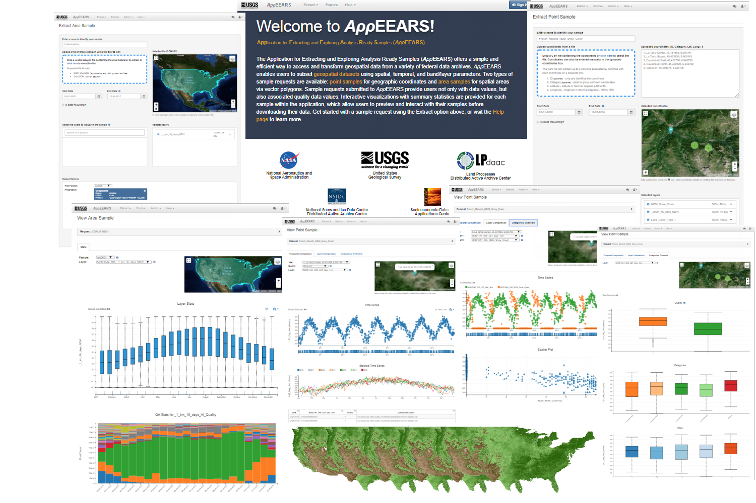
Application for Extracting and Exploring Analysis Ready Samples
Web application interface for accessing, processing, and visualizing geospatial data products that addresses data challenges by…
https://lpdaacsvc.cr.usgs.gov/appeears/

Slide 17
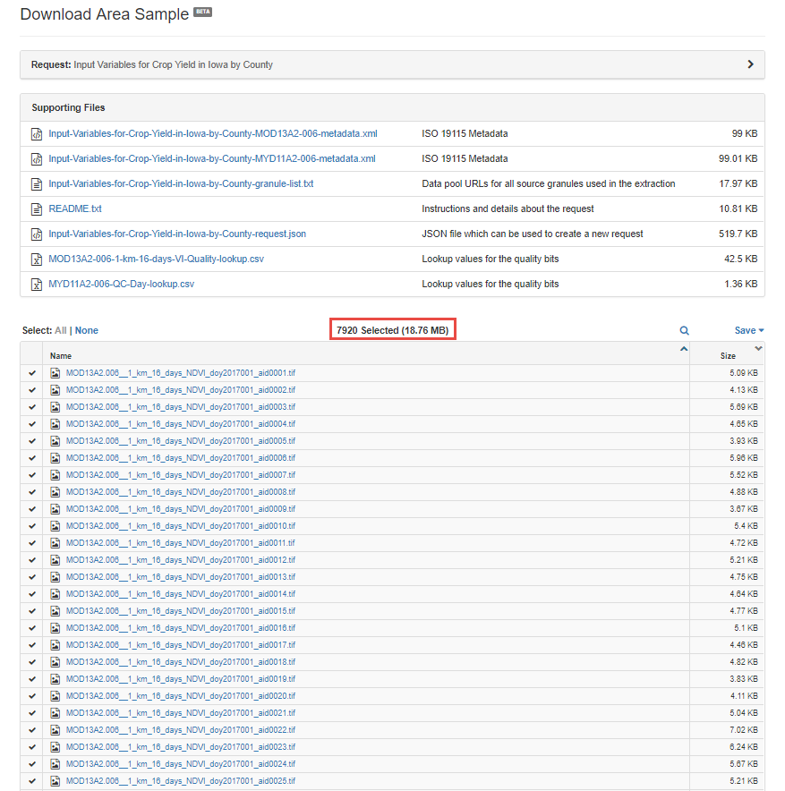
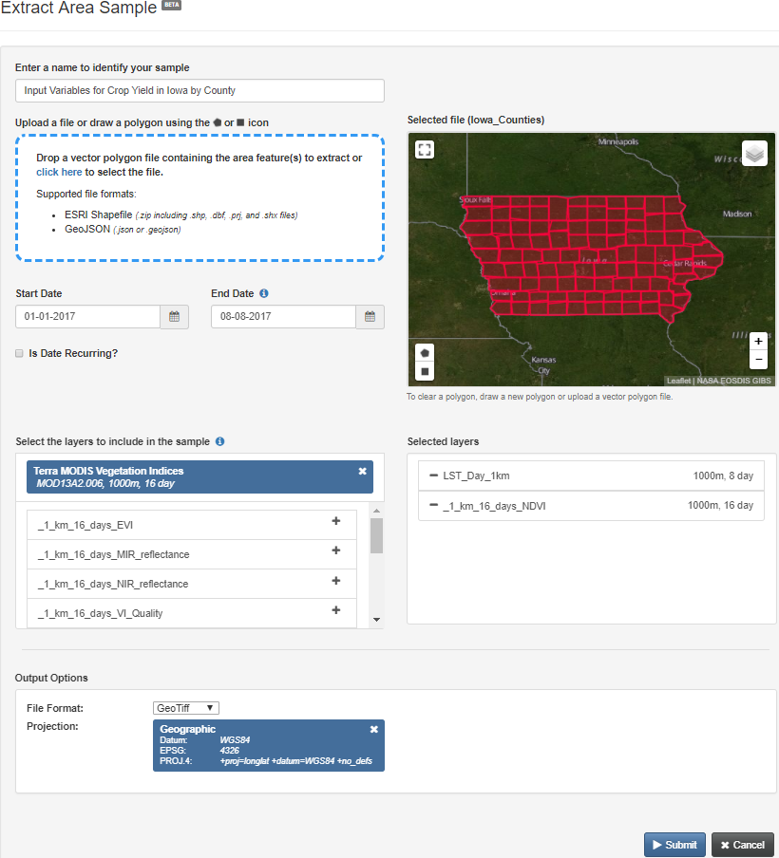
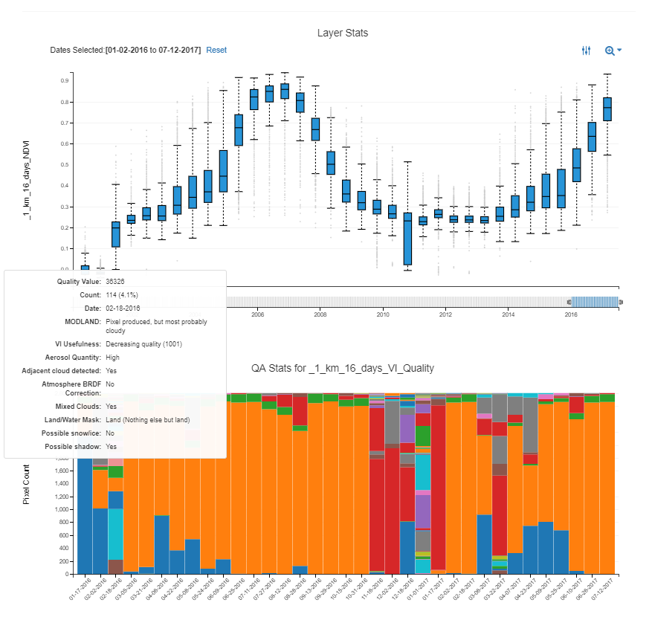
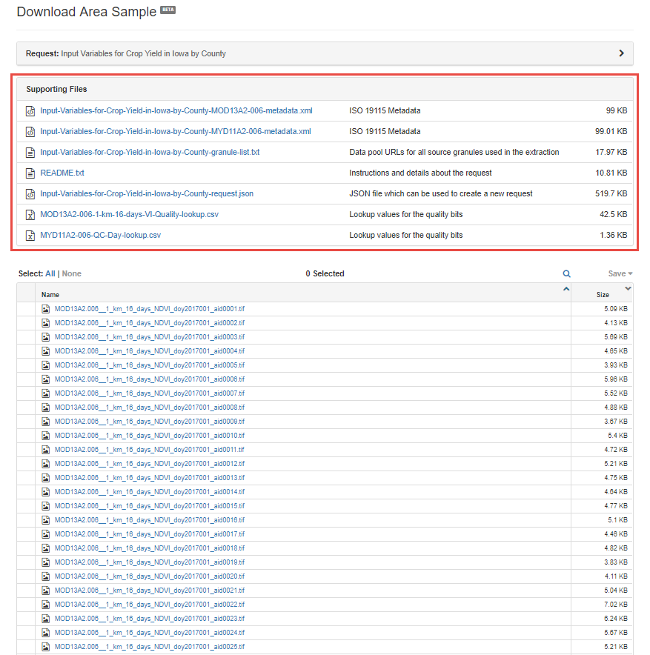
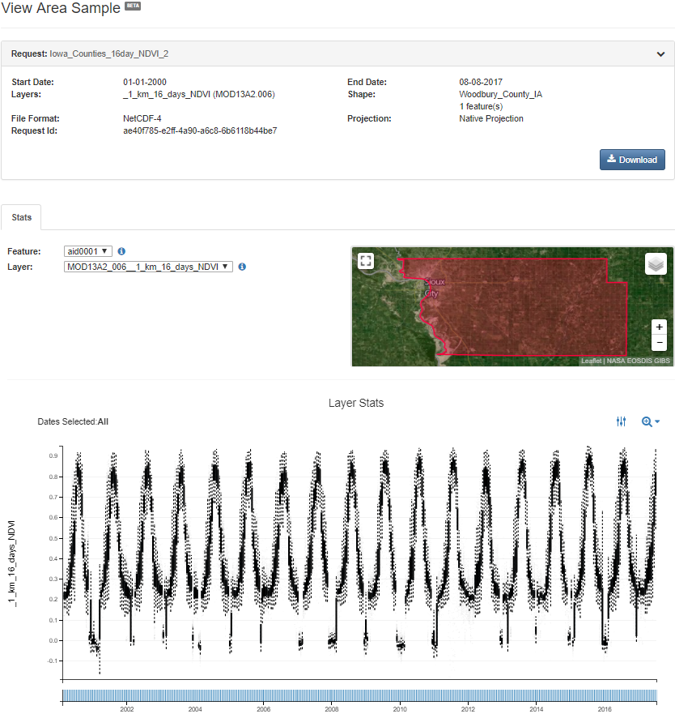
Spatial, temporal & band subsetting
Reprojection & reformatting
Interactive visualization
Quality measures apparent & usable
Interoperability & traceability
Reduced at-archive data volumes

Slide 18
NASA VIIRS Surface Reflectance and LAI/FPAR Products
LP DAAC
Terra and Aqua Moderate Resolution Imaging Spectroradiometer (MODIS) Land Products
LP DAAC
NASA MEaSUREs Web-Enabled Landsat Data (WELD) CONUS & AK
LP DAAC
Available Datasets
LP DAAC
NASA MEaSUREs Shuttle Radar Topography Mission (SRTM) v3
SEDAC
UN-Adjusted Gridded Population of the World v4
NSIDC DAAC
Terra and Aqua MODIS – Snow Products
NSIDC DAAC
Soil Moisture Active Passive (SMAP) Soil Moisture Products

Slide 19
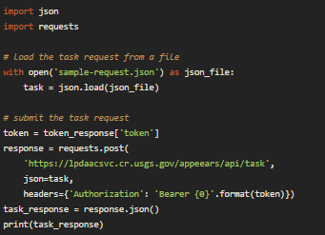

Newly Released Datasets:
USGS
Landsat Analysis Ready Data
JPL/LP DAAC
ECOSTRESS
ORNL DAAC
Daymet (Gridded estimates of daily weather parameters for NA)
Future Datasets:
LP DAAC
GEDI
S-NPP NASA Visible Infrared Imaging Radiometer Suite (VIIRS)
Additional MODIS Version 6 Data Products
New Functionality:
AρρEEARS API
AρρEEARS to the Cloud
NASA-compliant General Application Platform (NGAP)
NGAP

Slide 20

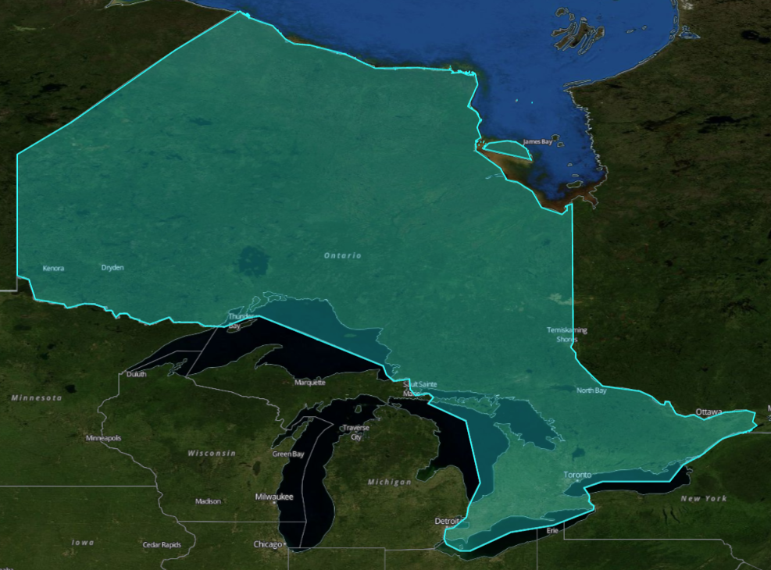
Can we break the 80/20 paradigm?
MOD13A3.006
_1km_monthly_NDVI
MCD12Q1.006
LC_Type2
MOD17A3.055
Npp_1km
Time Span
2001 – 2013
Study Area
Province of Ontario
1,076,395 km²
Single feature shapefile
Projection
Geographic
Format
GeoTIFF
Datasets
MODIS monthly/1 km NDVI
MODIS Annual/500 m LCT
MODIS Annual/1 km NPP
NASA SRTM 90 m DEM
Time to Complete
~ 40 minutes
Without AppEEARS
2146 files
29.1 GB
With AppEEARS
385 files
1.21 GB

Slide 21
Live Walk Through of AppEEARS
https://lpdaacsvc.cr.usgs.gov/appeears/

Slide 22
Use Case #1: AppEEARS Point Sampler
Tracking Deer Counts from Trail Cam-based Citizen Science and linking with vegetation, snow cover, and temperature data extracted from AppEEARS
Notes:
For the second half of the workshop, we want to walk through a couple of use cases as a group. We will first introduce the use case and then encourage you to follow along in AppEEARS using the instructions we handed out earlier. The goal of going through these use cases is to show you how you can leverage AppEEARS to connect your conservation biology data with remote sensing data-derived environmental descriptors, for things like modeling species richness and behaviors. For the first use case, we will take a look at tracking deer behavior with citizen science using Trail Cams, and linking those data with vegetation, snow cover, and temperature data extracted from AppEEARS.

Slide 23
Citizen Science Project: Snapshot Wisconsin
WHAT: Combining Whitetail Deer frequency data with environmental metrics such as land surface temperature, snow cover, and vegetation greenness to predict species richness for a given location
WHERE: U.S. State of Wisconsin
WHY: Assess # of deer in WI to aid wildlife management decisions
WHEN: 2010-Present
HOW: Citizen Science Project: Snapshot Wisconsin
1,000 volunteers have set up over 1,100 trail cameras, collecting 19 million images, and then crowd-sourced image classification
Combined with satellite data from MODIS
Notes:
The first use case comes from Snapshot Wisconsin, which is a citizen science project hosted by the Wisconsin DNR, and that has had collaborations with NASA to do some analysis on Deer behavior and counts. So here we plan to combine whitetail deer frequency and behavior data with environmental metrics such as land surface temperature, snow cover, and vegetation greenness to develop a model that predicts the likelihood of deer exhibiting certain behaviors on any given day. This use case takes place across the state of Wisconsin. The reason why the Wisconsin DNR set up Snapshot Wisconsin was to assess the number of deer and their behavior throughout the state in order to aid in wildlife management decisions. The program started in 2010, and to date over 1000 wisconsonians have set up and maintained over 1100 trail cameras across the state, collecting 19 million images. The images are hosted on a website where citizen scientists can classify images by identifying species and also noting specific behaviors such as feeding. The NASA partnership comes in because the researchers are interested in combining this information with satellite data from MODIS, in order to see what impacts the environmental conditions have on deer frequency and behavior.

Slide 24
Combining Species Abundance data with Remote Sensing Data-derived Environmental Descriptors
Research Question:
How can AppEEARS be used to generate remote sensing-derived environmental descriptors for predicting species richness and behavior for point locations?
Goal:
Access remotely sensed data that can be used to derive environmental descriptors for use in species richness studies without:
(1) downloading the source data for the remote sensing datasets
(2) needing to open remote sensing software
Notes:
So here we aim to combine species abundance data with remote sensing data derived environmental descriptors, in order to answer the question: How can AppEEARS be used to generate remote sensing-derived environmental descriptors for predicting species richness and behavior for point locations? The goal of this exercise is to access remotely sensed dat that can be used to derive environmental descriptors for use in species richness studies without ever needing to download the source data from the remote sensing datasets, nor needing to open remote sensing software.

Slide 25
Datasets
Data Product | Temporal Extent | Temporal Resolution | Spatial Resolution | Layer Name | Description | Units | Environmental Descriptors:
NBAR Surface Reflectance (MCD43A4.006) | 2000-Present | Daily | 500 m | Nadir_Reflectance_Band1Nadir_Reflectance_Band2 | NBAR at local solar noon | Ref | Daily NDVI
Land Surface Temperature (MOD11A1.006) | 2000-Present | Daily | 1000 m | LST_Day_1km | Daytime Land Surface Temperature | K | Daily Max Temp
Snow Cover (MOD10A1.006) | 2000-Present | Daily | 500 m | NDSI_Snow_Cover | NDSI snow cover | % | Percent Snow Cover
Notes:
Before we dive into the process, here is some information on the datasets that we will be using for this exercise. First we have the daily 500 m resolution NBAR surface reflectance product, which we will be using the red and NIR bands to generate daily NDVI from. Second, we have daily LST from MODIS, which could be used to link to deer behavior, i.e. are deer more active on hot days or cool days? Lastly, we will be ordering Snow cover data from NSIDC, which will give us an indicator on the daily amount of snowcover on the ground for our trail cam sites.

Slide 26
AppEEARS Request Parameters
Spatial Subset:
CSV file containing lat/lon locations of trail cameras throughout Wisconsin
Temporal Subset:
Jan 1 to December 31, 2015 (one season)
Layer Subset:
MODIS NBAR Surface Reflectance (MCD43A4.006)
Nadir_Reflectance_Band1
Nadir_Reflectance_Band2
MODIS Land Surface Temperature (MOD11A1.006)
LST_Day_1km
MODIS Snow Cover (MOD10A1.006)
NDSI_Snow_Cover
Notes:
So here we have lat/lon locations for some of the trail cams that we will upload into AppEEARS to define our spatial region of interest. We will order data from the most recent full season, 2017, and request the layers that I just described.

Slide 27
Live Hands-on Activity
https://lpdaacsvc.cr.usgs.gov/appeears/
https://science.nasa.gov/earth-science/applied-sciences/making-space-for-earth/wisconsin-wildlife-says-cheese

Slide 28
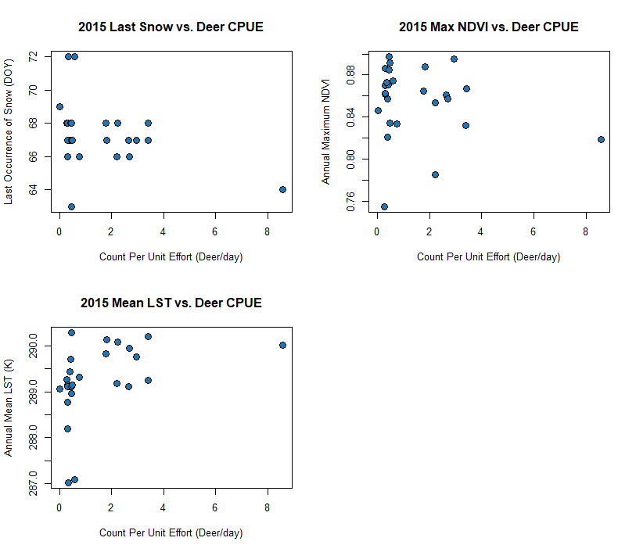
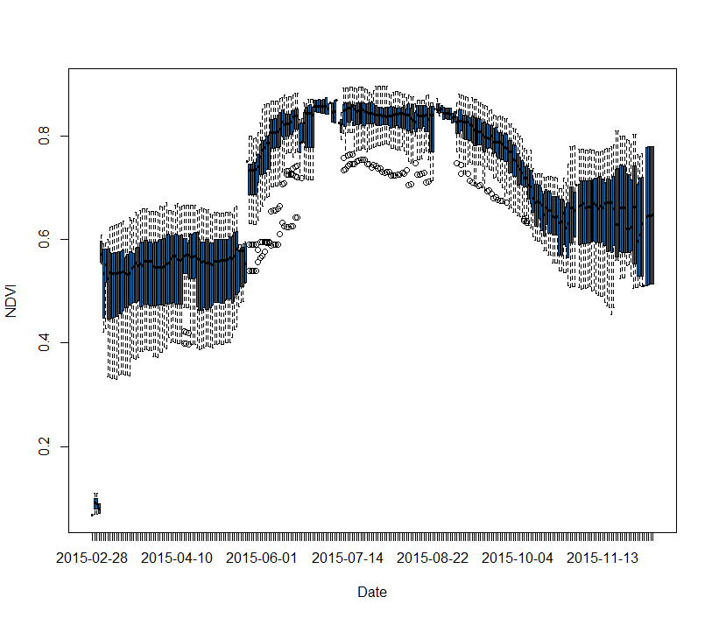
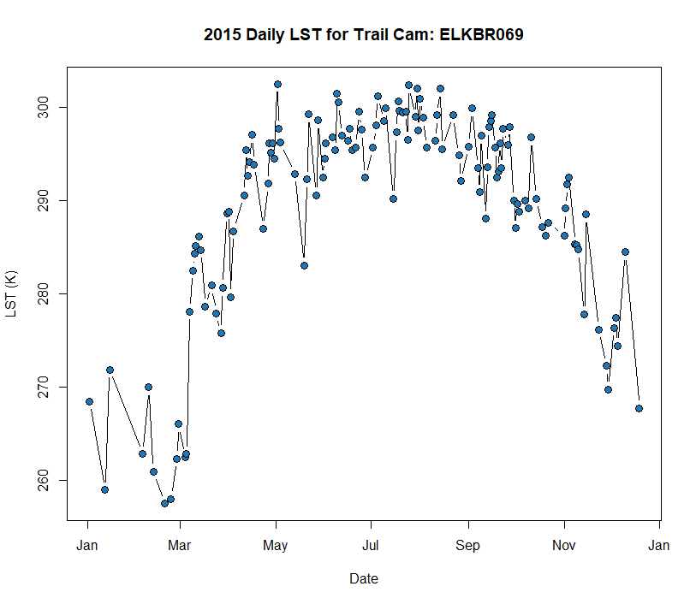
R Script for Additional Analysis
Open R/RStudio
Load SCGIS_UseCase.R into your workspace
Available at: https://github.com/cpkrehbiel/SCGIS_2019
Notes:
So thanks Cindy for showing how to do some basic quality filtering in excel. Some of you may want something a little more powerful or repeatable, so
I can show you a basic R script for importing AppEEARS point outputs into R and doing some quality filtering and visualization.
OK so if everyone will go ahead and open R or Rstudio, I have a short script that we can move through to give you some ideas for how you can quality filter AppEEARS outputs and visualize your results in R. If you haven’t already, go ahead and download the R script at the repository provided.

Slide 29
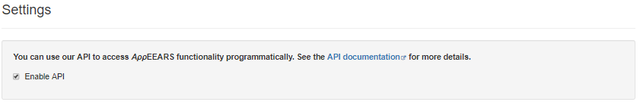
Use Case #2: AppEEARS API/Area Sampler
Using the AρρEEARS API in your Analysis Workflow - Getting Started
Go to: https://github.com/cpkrehbiel/SCGIS_2019
Enable API Access at: https://lpdaacsvc.cr.usgs.gov/appeears/settings

Slide 30
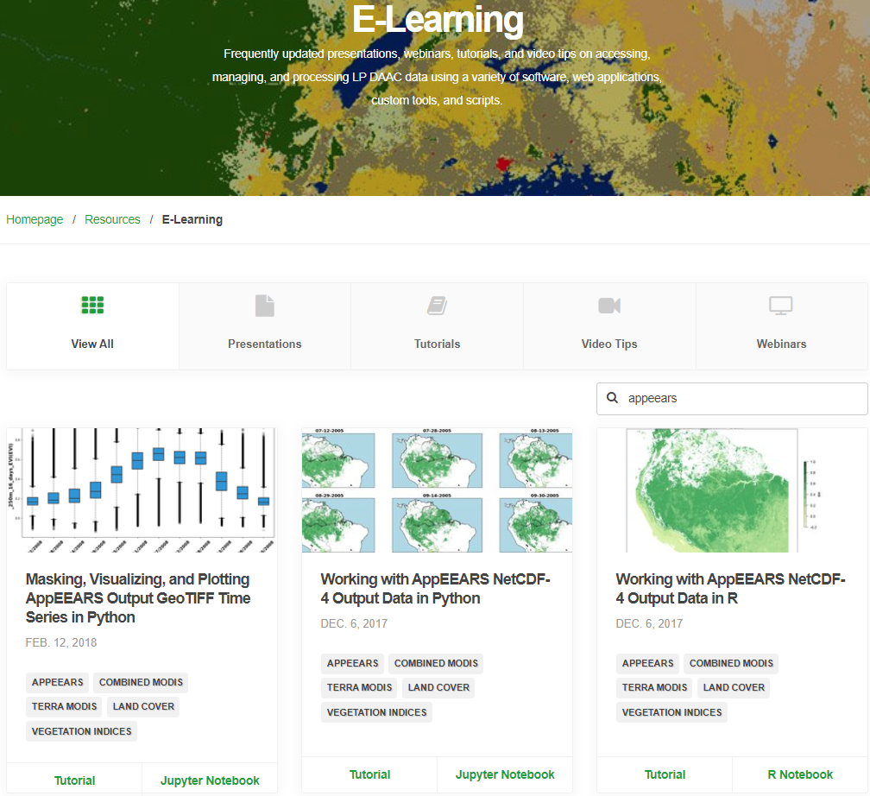
LP DAAC E-Learning Resources
https://git.earthdata.nasa.gov/projects/LPDUR/repos/appeears-api-getting-started/browse
https://lpdaac.usgs.gov/resources/e-learning/#appeears

Slide 31
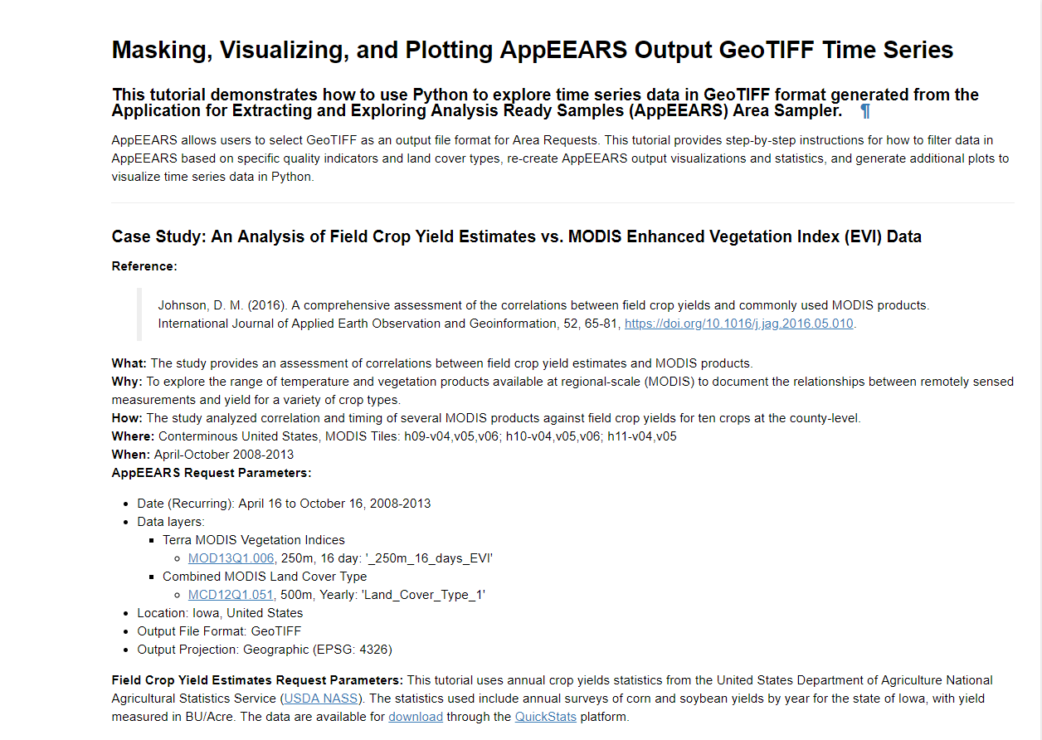
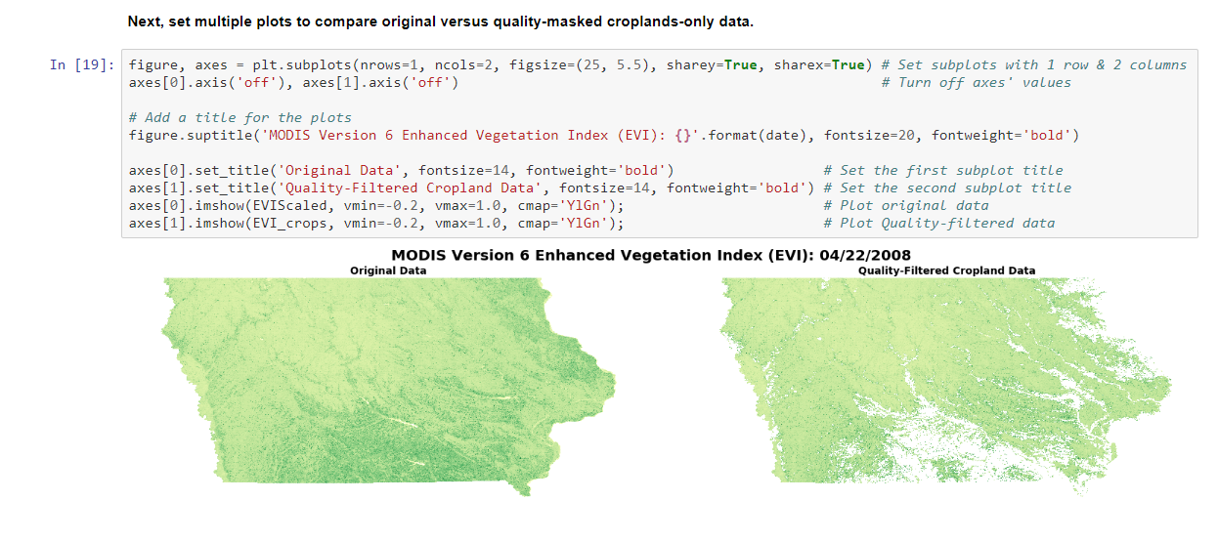
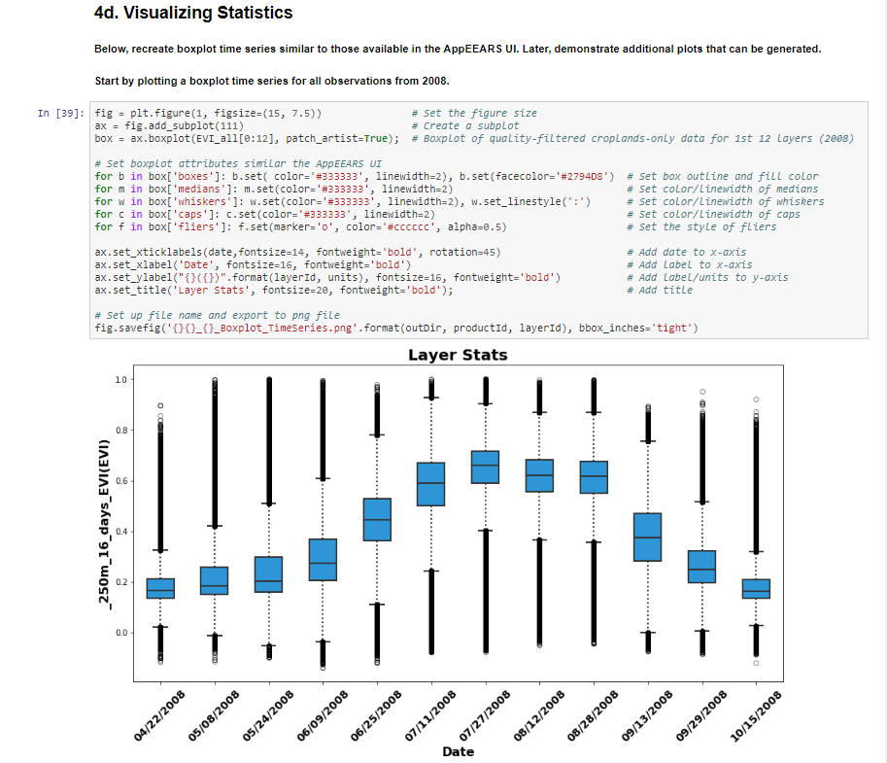
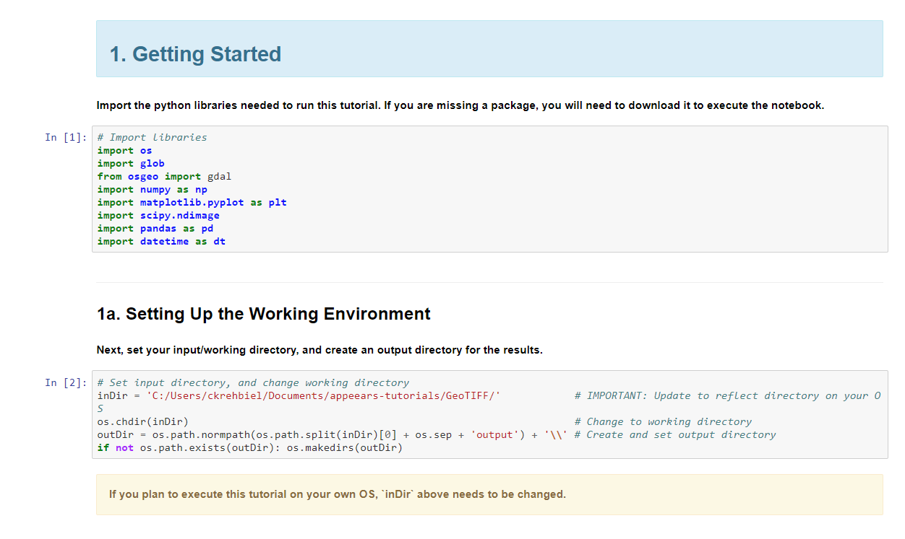

Slide 32
Questions?
User Services
https://lpdaac.usgs.gov/lpdaac-contact-us/
Try out AρρEEARS:
https://lpdaacsvc.cr.usgs.gov/appeears
Subscribe to the LP DAAC Listserv:
https://lists.nasa.gov/mailman/listinfo/lpdaac

Slide 33
Questionnaire/Course Assessment
Additional functionality/datasets desired in AppEEARS?
AppEEARS:
What did you like?
What didn’t you like?
What would you change?
What resources would you want to help learn more about AppEEARS or the data within AppEEARS?
Tutorials? Videos? Both?

